Slide 1
Lending Club Case Study
RISHABH NEGI

Slide 2
Objective
The Objective of this case study is to implement EDA technique on a real world problem and understand the insights and present in a business first manner via presentation.
Benefits of the case study:
Gives a idea about how EDA is used in real life business problems.
It also develops a basic understanding of risk analytics in banking and financial services.
How the data is used to minimize loss of money while lending it to clients.
It improves our understating of visualization and what charts to use for real life data.

Slide 3
Business Understanding
The business objective is to take a decision whenever they receive a loan application whether to reject or approve based on certain variables.
Dataset Details:
The data given below contains information about past loan applicants and whether they ‘defaulted’ or not. Data has details regarding approved loan not the rejected ones. It has 3 status of loan which is Fully Paid, Current and Charged-Off.
Data Clean-up and preparation process:
Importing the Data
Removing large null value columns
Removing irrelevant columns
Removing/Fixing null values
Correcting data types and deriving new columns
Filter Data for requirement.
Removing Duplicate Data
Removing outliers

Slide 4
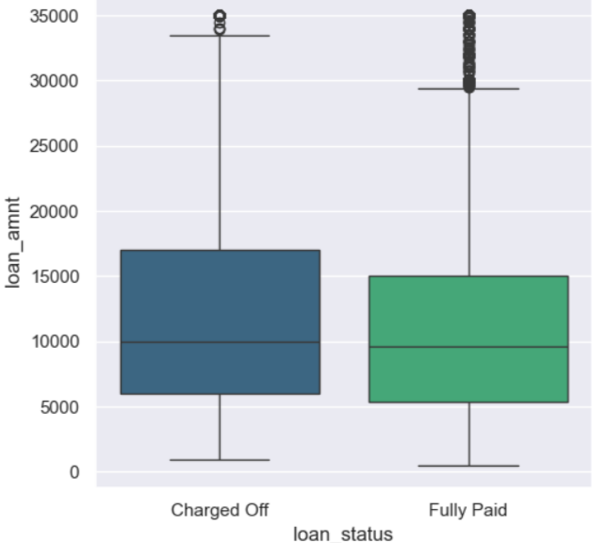
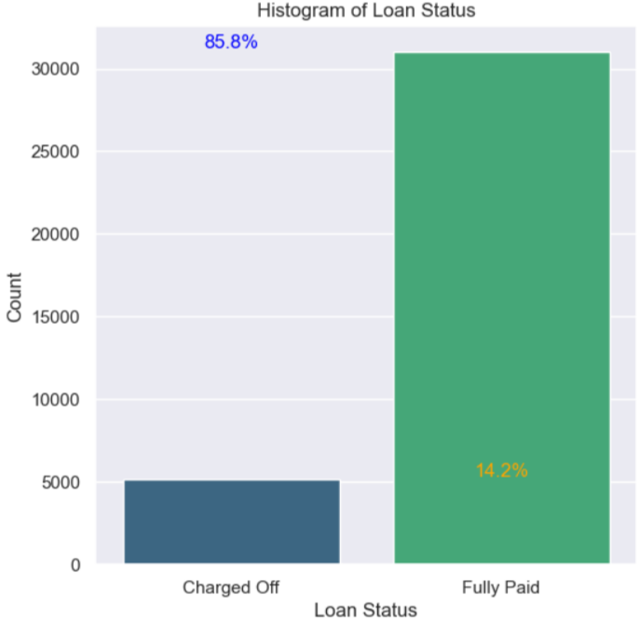
Loan Status and Amount
Loan Amount: It varies from 500 to 35000 with a median of 10000. Loan amount is majorly small and very few clients have taken large loans and larger it goes we have higher chance of defaulting.
Loan Status: The number of charged off loan is much smaller(14.5%) compared to total count.

Slide 5
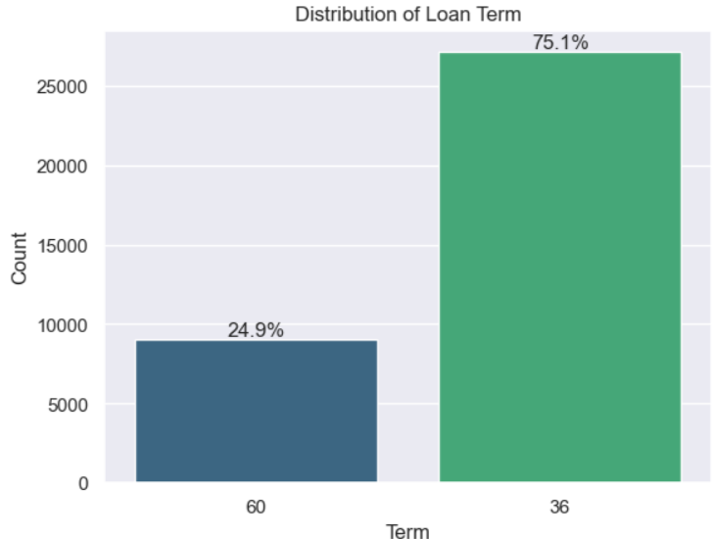
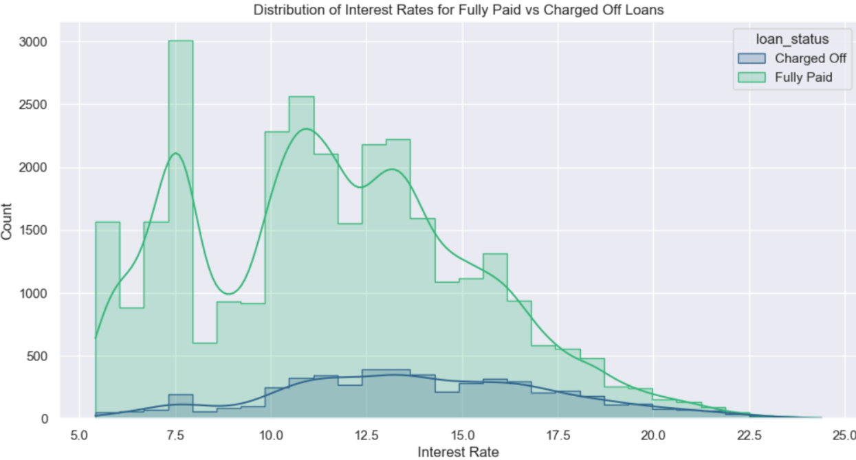
Term and Interest Rate
Loan Term: The Loans taken for 36 month term are much more than 60 months and have lower chance of defaulting.
Interest Rate: The count of loan taken varies with interest rate showing peak around in 5-15 bracket and decreasing slowly where as the chance of defaulting increases with interest rate.

Slide 6
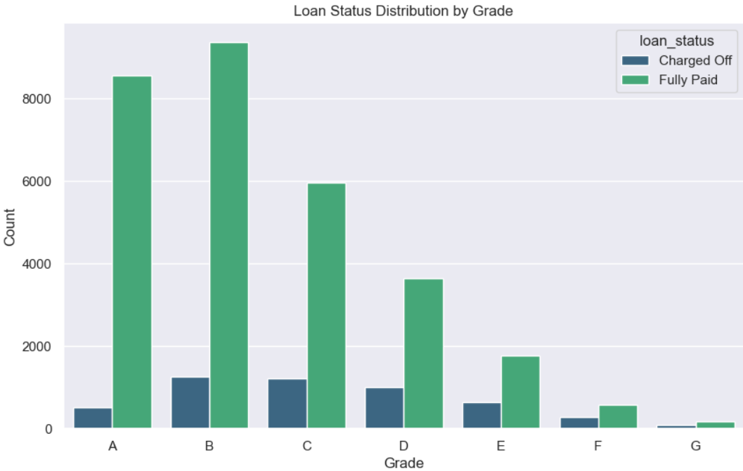
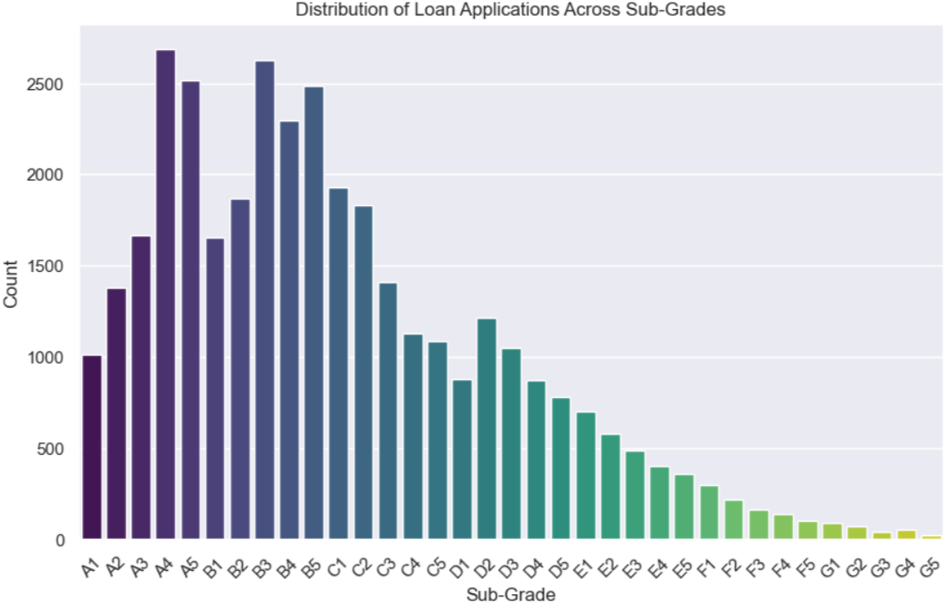
Grade and Sub-Grade
Grade: The loan approved are majorly of higher grade as they are of low risk thus low chance of defaulting. 60 month term loans have larger number of lower grade loans with high risk.
Sub Grade: This provides more insight that the loans within grade are more skewed towards lowered sub grades.

Slide 7
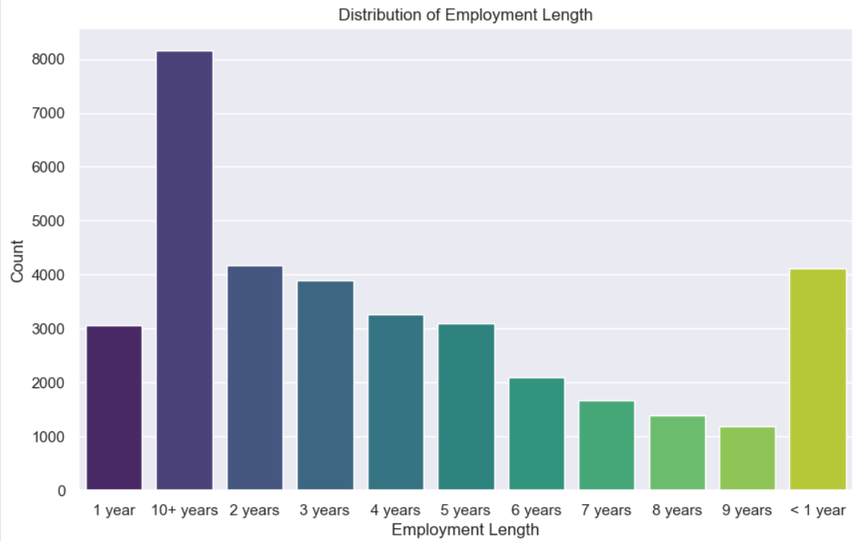
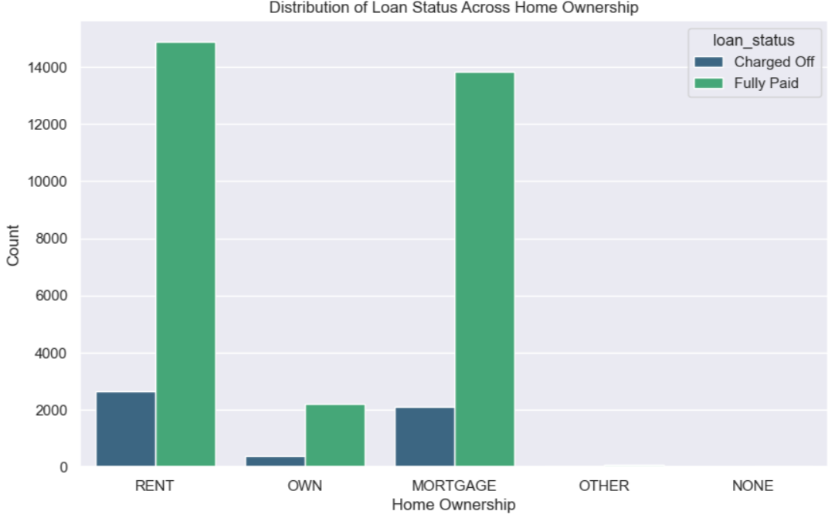
Employment Length & Homeownership
Employment Length: Majority of clients have 10+ years of experience and has highest number of defaulted loan.
Home Ownership: Majority of clients are lacking ownership of any property and are on rent or mortgage and have a higher chance of defaulting.

Slide 8
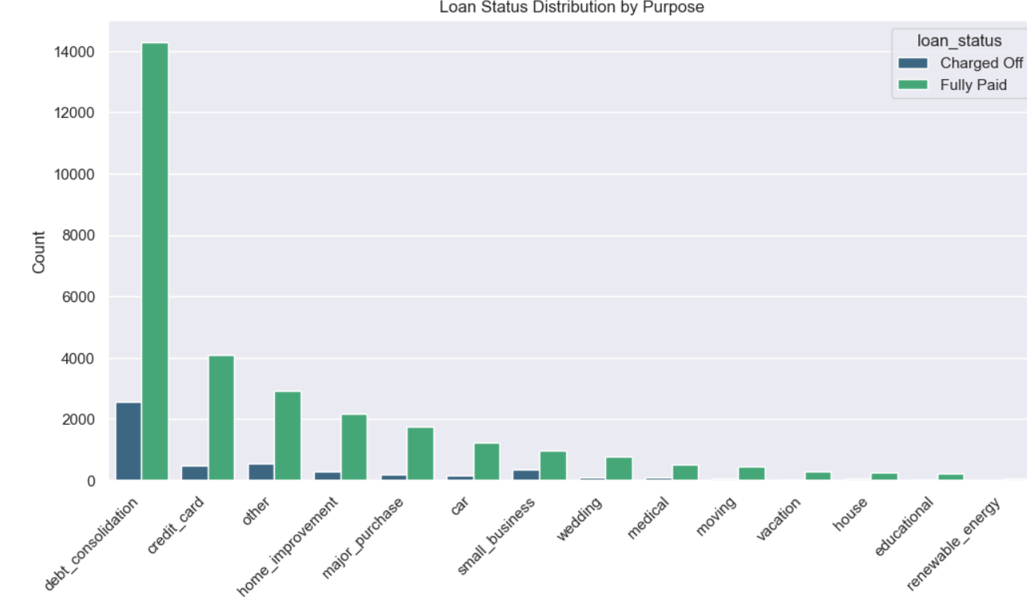
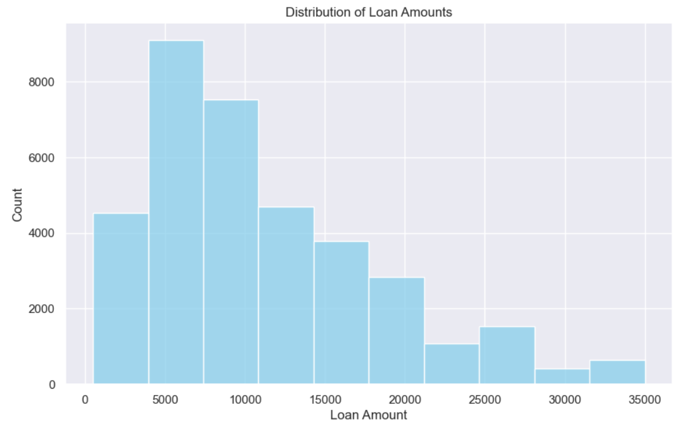
Loan Amount & Purpose
Loan amount : The loan amount is majorly spread around 50000 to 17000
Purpose: Loans are taken mostly for debt consolidation followed by credit card payment. Whereas the debt consolidation has highest fully paid loan but also has highest defaulted loans as well.

Slide 9
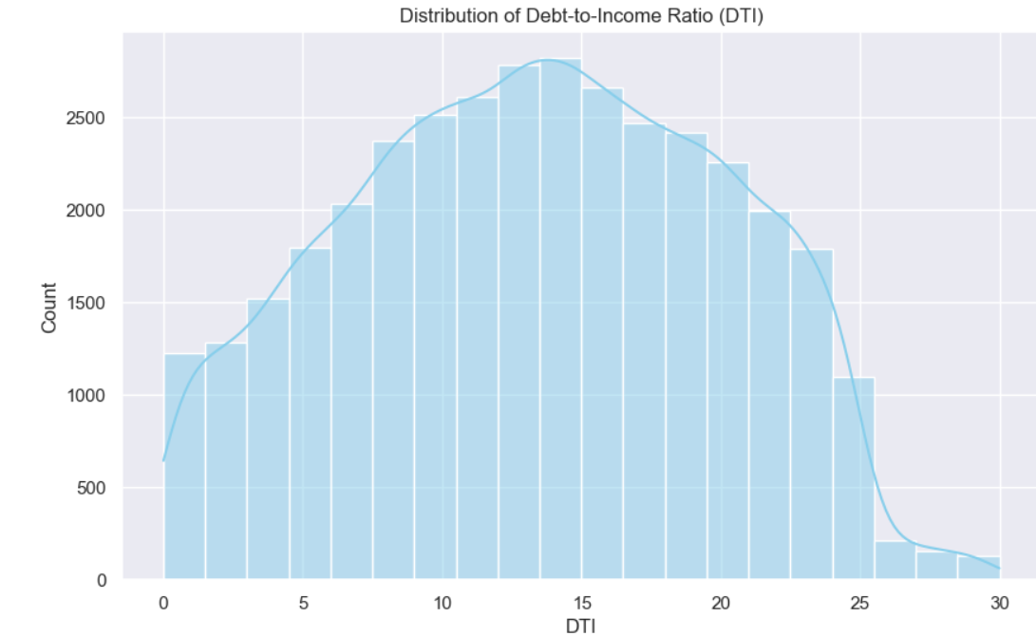
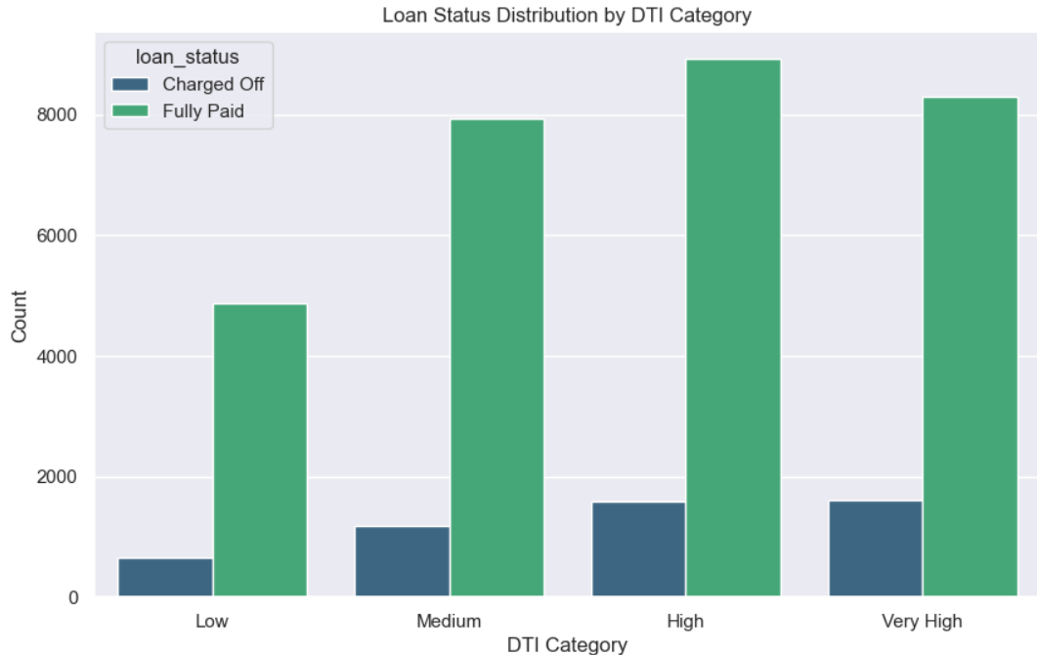
DTI ratio
DTI: The large percentage of Clients have a large Debt to Income ratio which shows that lending to such clients can be very risky.
When DTI reach 12 the defaulters are start to increase

Slide 10
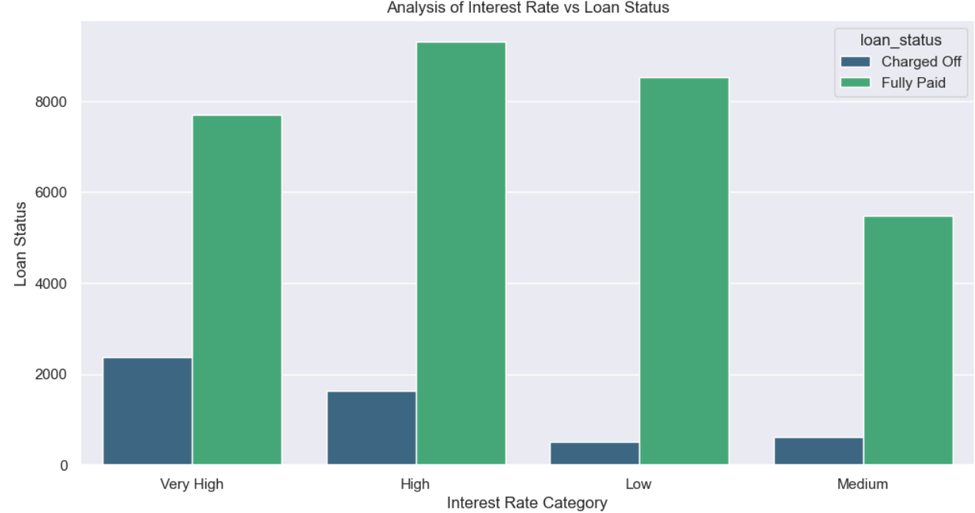
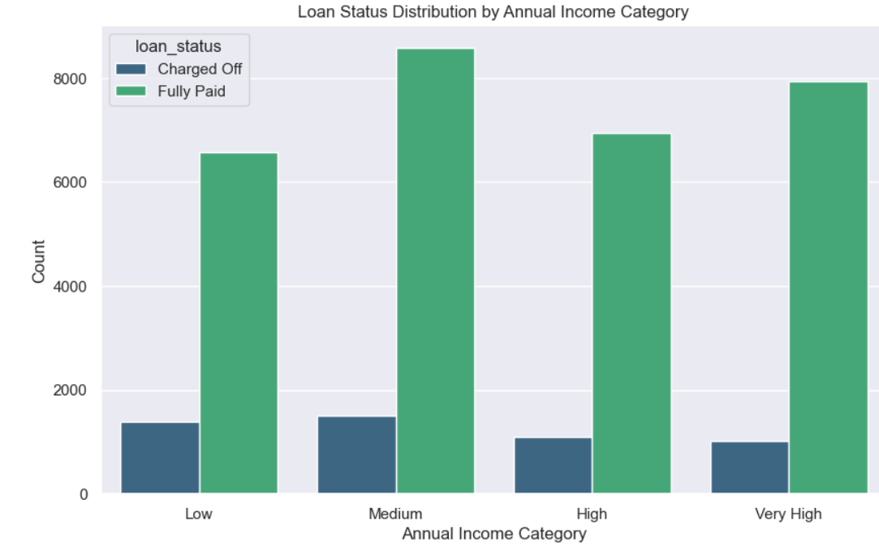
Loan Status vs Interest rate and Annual Income vs Loan status
Annual Income is inversely proportional to loan default i.e., as the income increases the loan default decreases. Loan default is very high with the low annual income group i.e., less than 41000
The defaulters are more for interest rate of 14 % and above

Slide 11
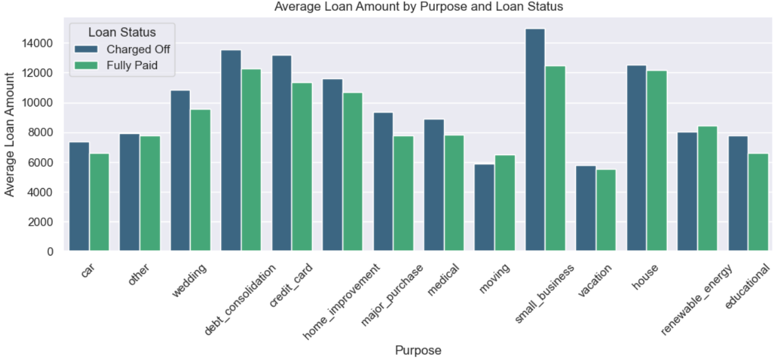
Applicants defaults for Purpose
* More number of applicants have taken loan for Small Business followed by debt consolidation.
* Applicants who have taken loan for small business lend to default more.

Slide 12
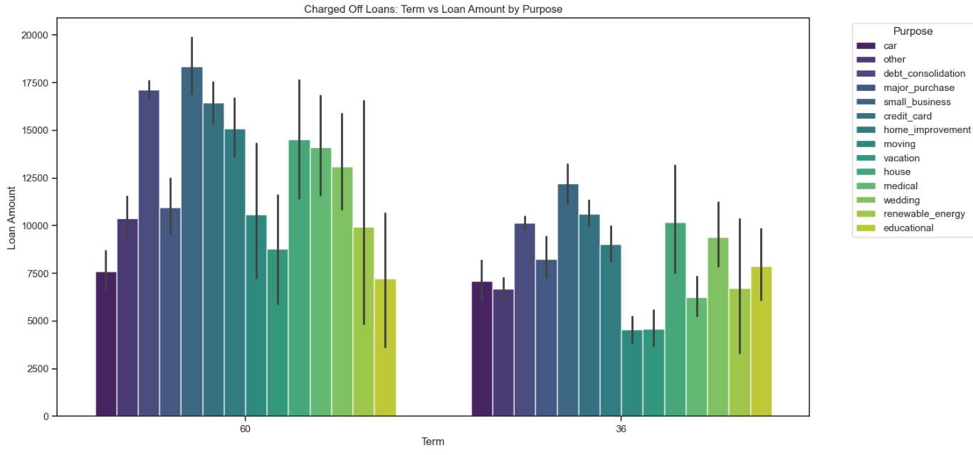
Analysis of Term vs Loan Amount vs Purpose of Charged off loan
More number of applicants have taken a duration of 60 months period for small business loan

Slide 13
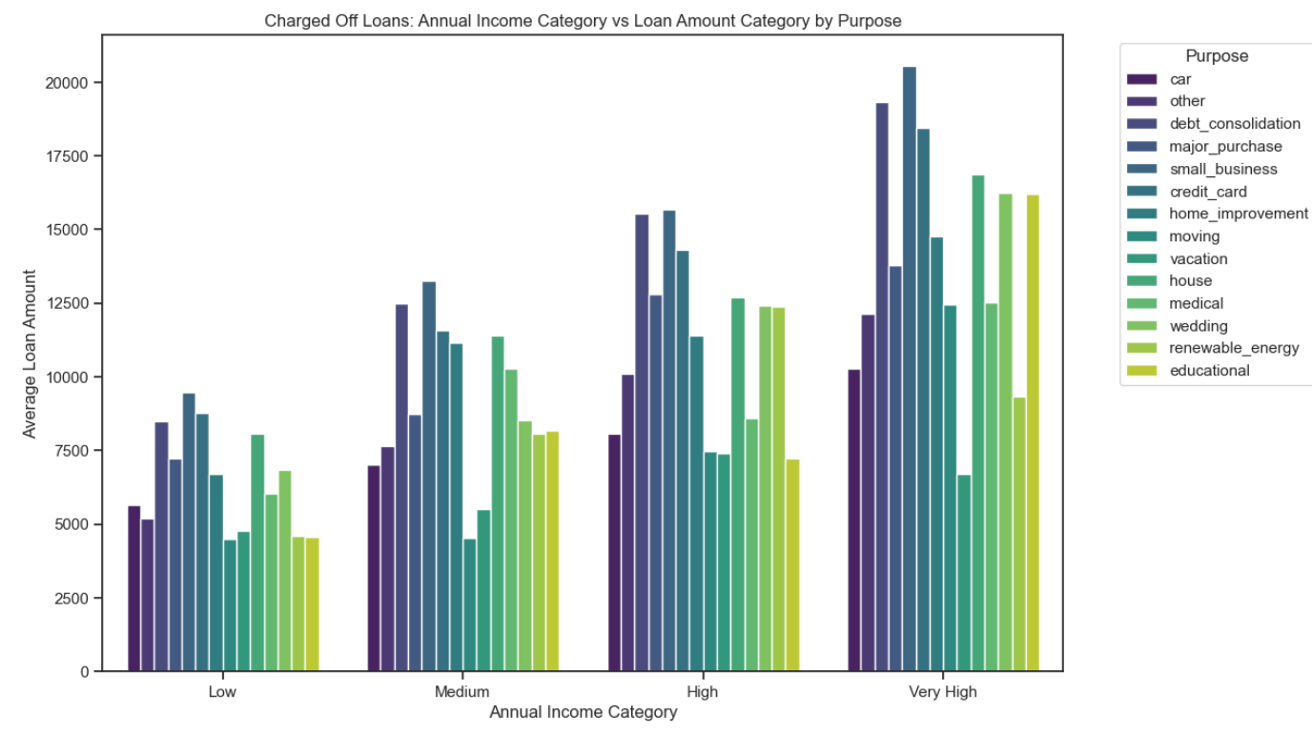
Analysis of Annual Income vs Loan Amount vs Purpose of Charged off loan
*Number of applicants who have taken small business is more across various annual income group. However applicants under the category of high income have taken more loan for debt consolidation followed by small business.

Slide 14
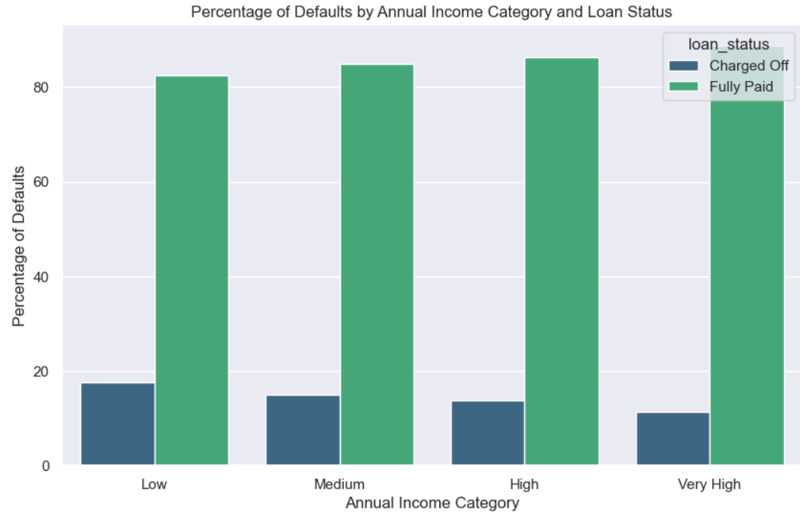
Default rate in Annual Income
*Default rate highest amongst the low annual income (17.5%)group i.e. whose income less then 40000 per annum

Slide 15
Analysis conclusion
Recommendations
Major Driving factor which effect the chance of defaulting and avoiding Credit Loss after analysis of loan amount and loan status been compared :
1. Employment length
2. Grades
3. Interest rate
4. Annual income
5. Purpose for which loan is taken
6. Grade
As per the analysis it can be inferred that applicants that are low income group and have taken higher interest loan with longer duration for small business have more probability of defaulting. Hence extra care should be taken care before lending them loan.
.

